Slide 1
HB Field Mapping
Eric Sun
Mike Fowler
Steven Lassiter

Slide 2
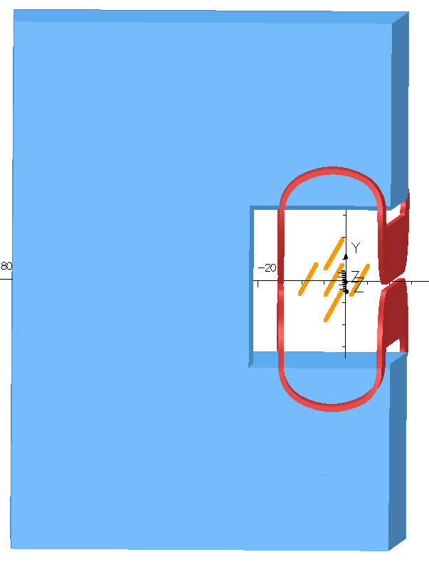
HB Field Mapping
57 points along ~Z axis per tube.
5 tube locations, starting at top and going in a clockwise rotation with #5 near the center line.
Four current excitations
2,000A
3,000A
3,500A
3,900A
Tube 1
Tube 5 center
Tube 4
Tube 2
Tube 3

Slide 3
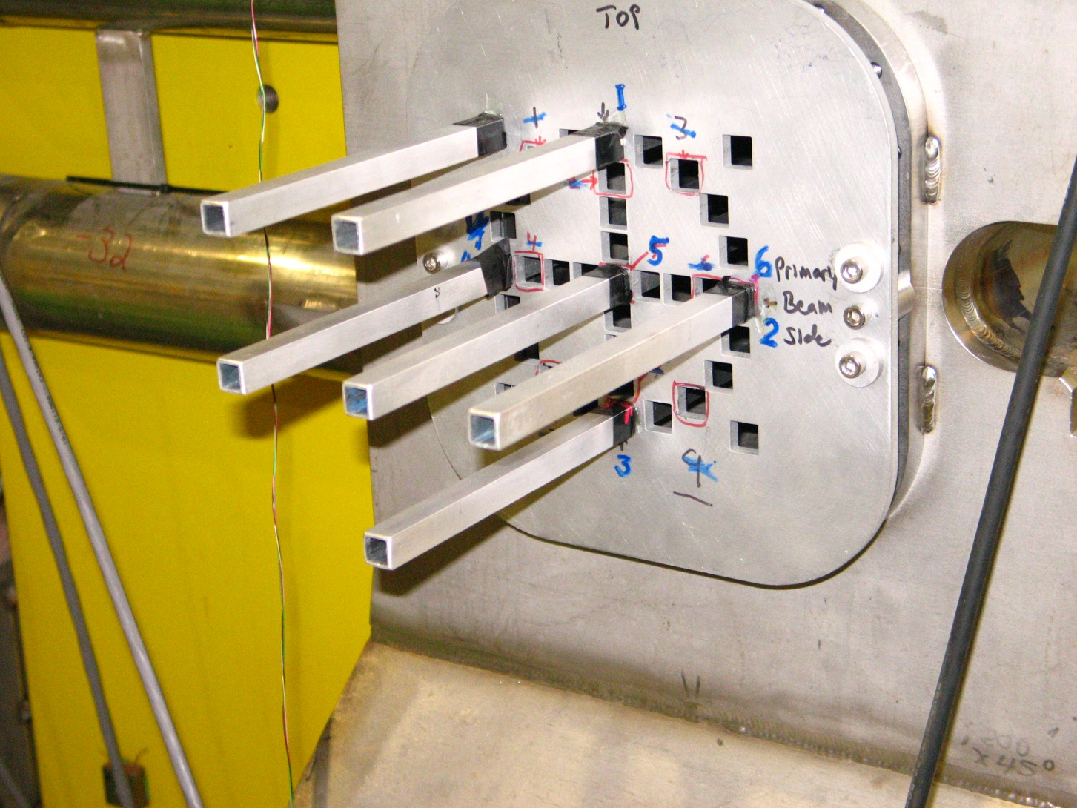
Mapping Hardware

Slide 4
Measured Data vs Tosca
Tosca model of as built yoke with original coils.
Measured data NOT corrected for current variations (less than 0.03%)
Tubes starting and end points were surveyed relative to magnet coordinates.
Z locations were estimated using tape measurement to mark scribes on rod. These markers were then aligned to entrance end of tube.

Slide 5
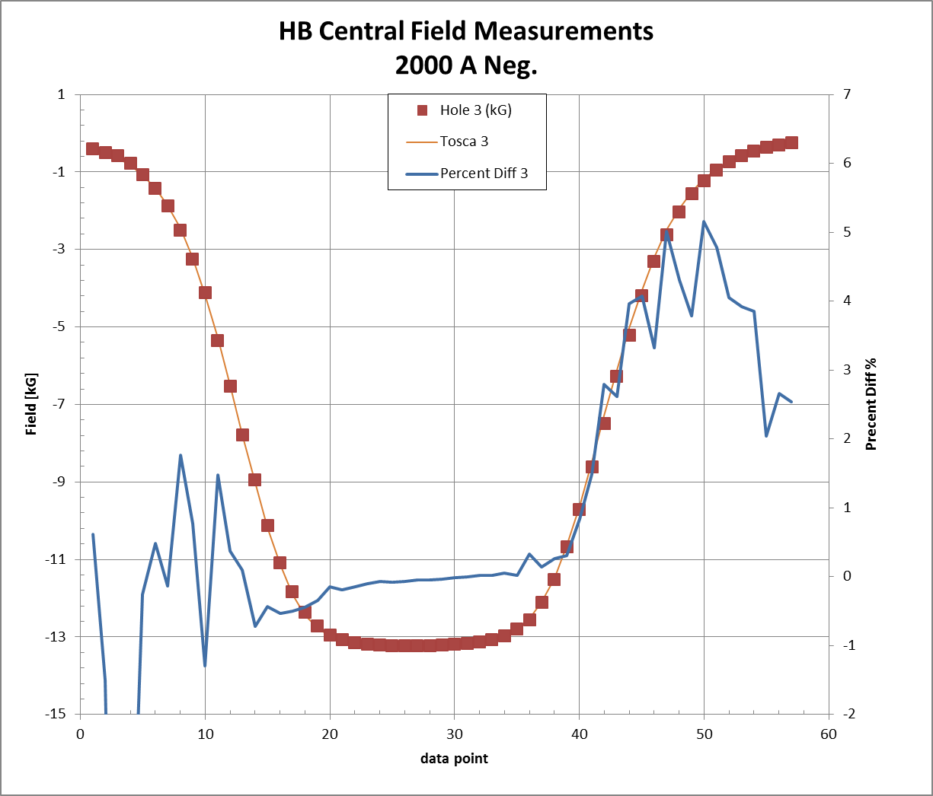
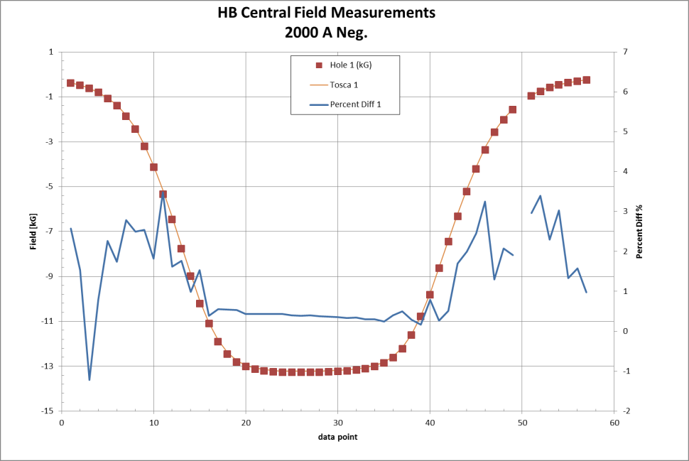
2,000A Tube 1 & 3 (Top and Bottom)
Average Error 1.21%
Average Error 0.79%

Slide 6
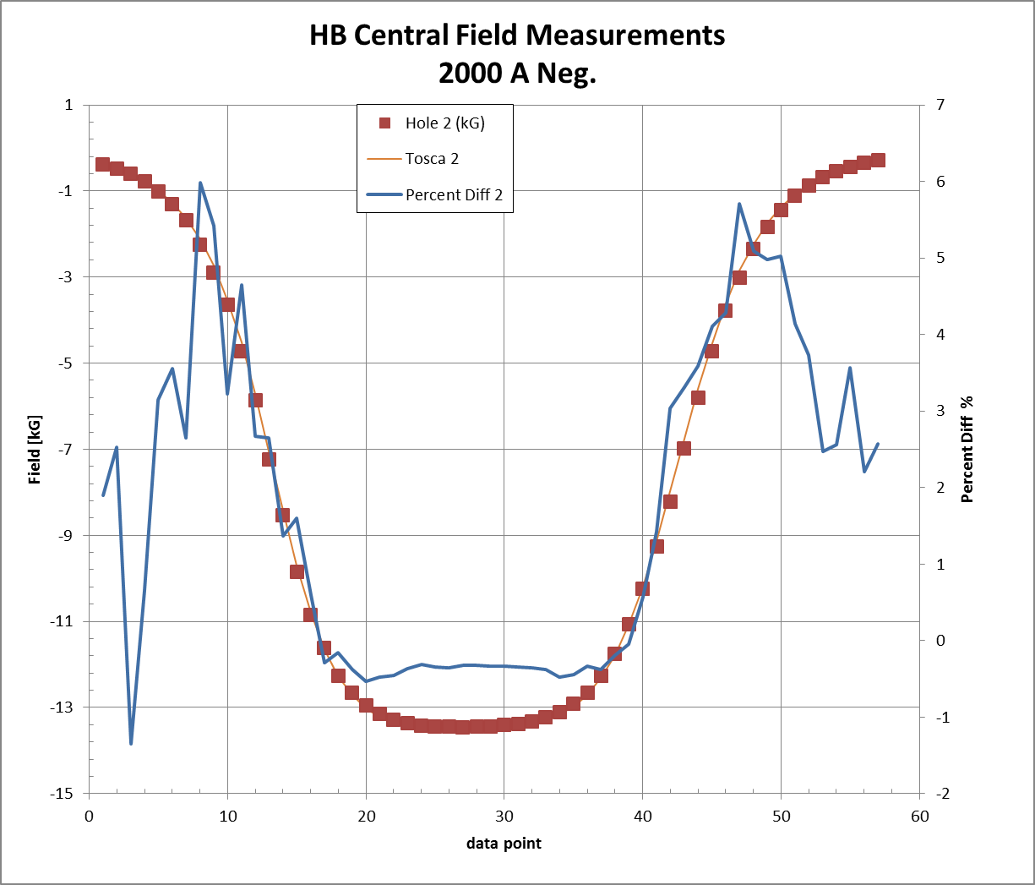
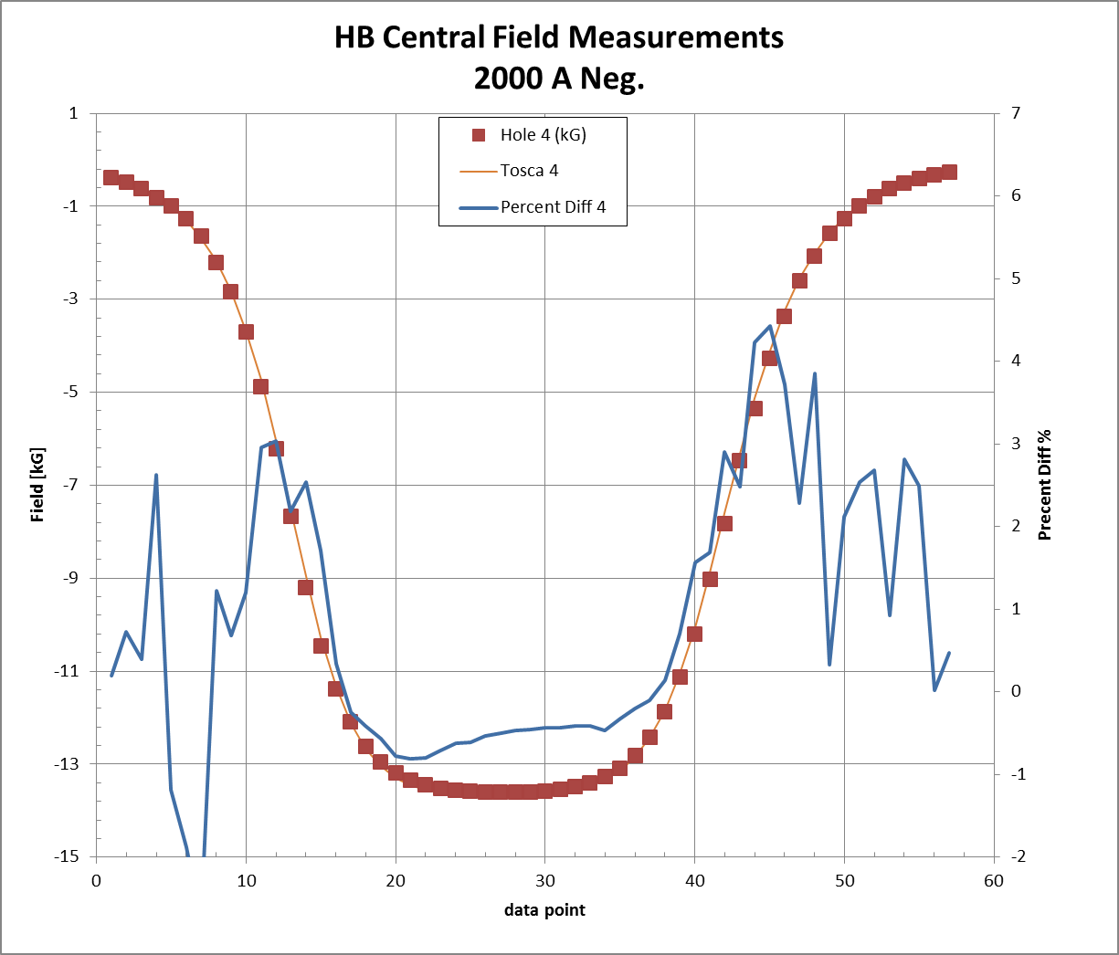
2,000A Tube 2 & 4 (Right and Left)
Average Error 1.68%
Average Error 0.81%

Slide 7
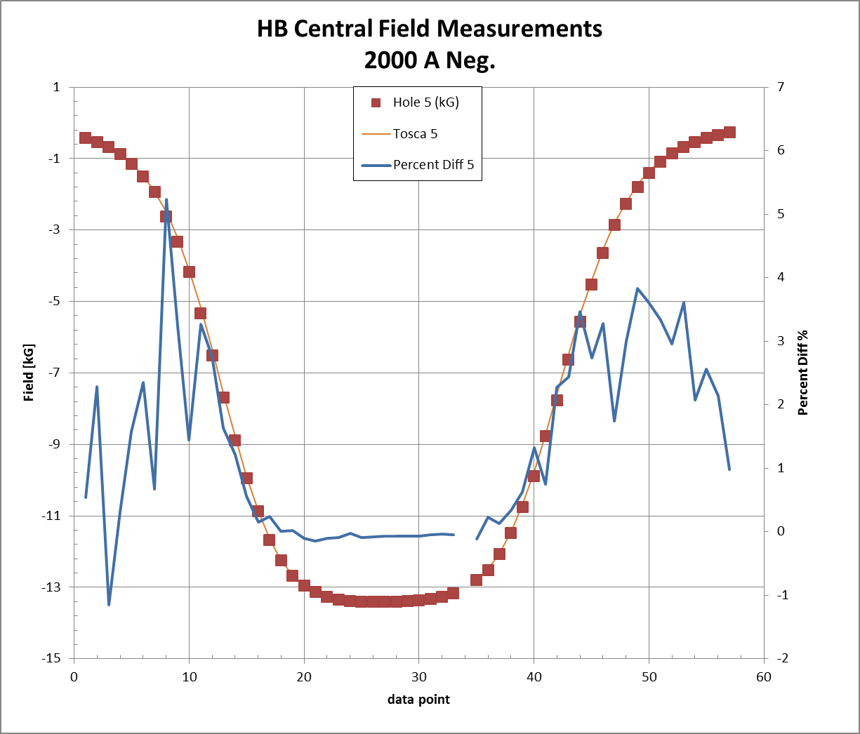
2,000A Tube 5 Center
Average Error 1.30%

Slide 8
3000A

Slide 9
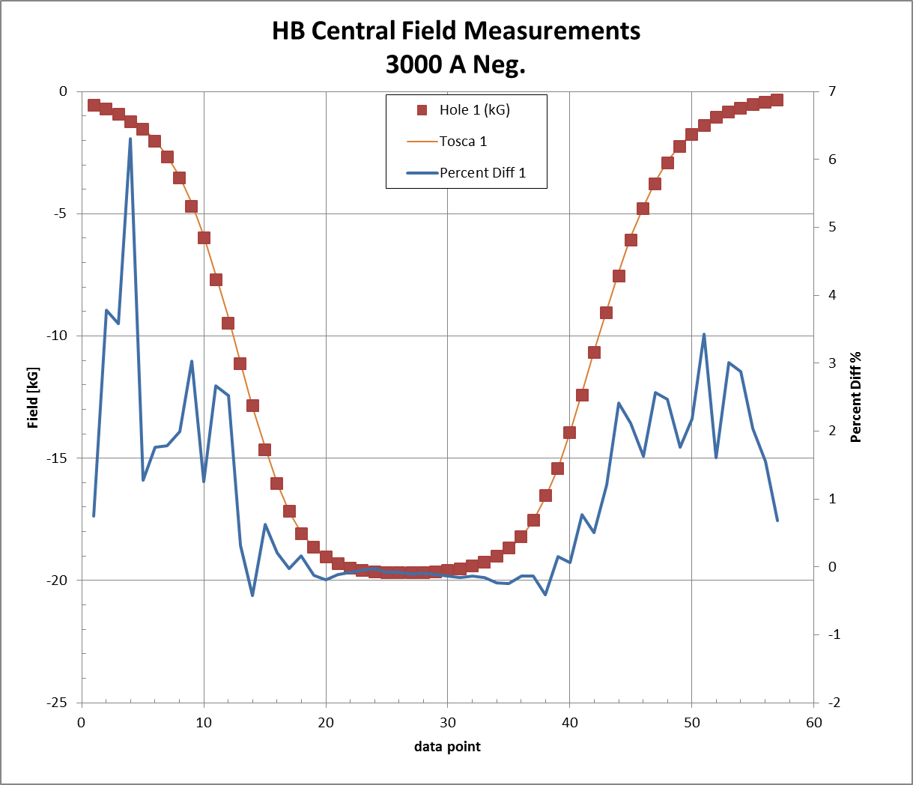
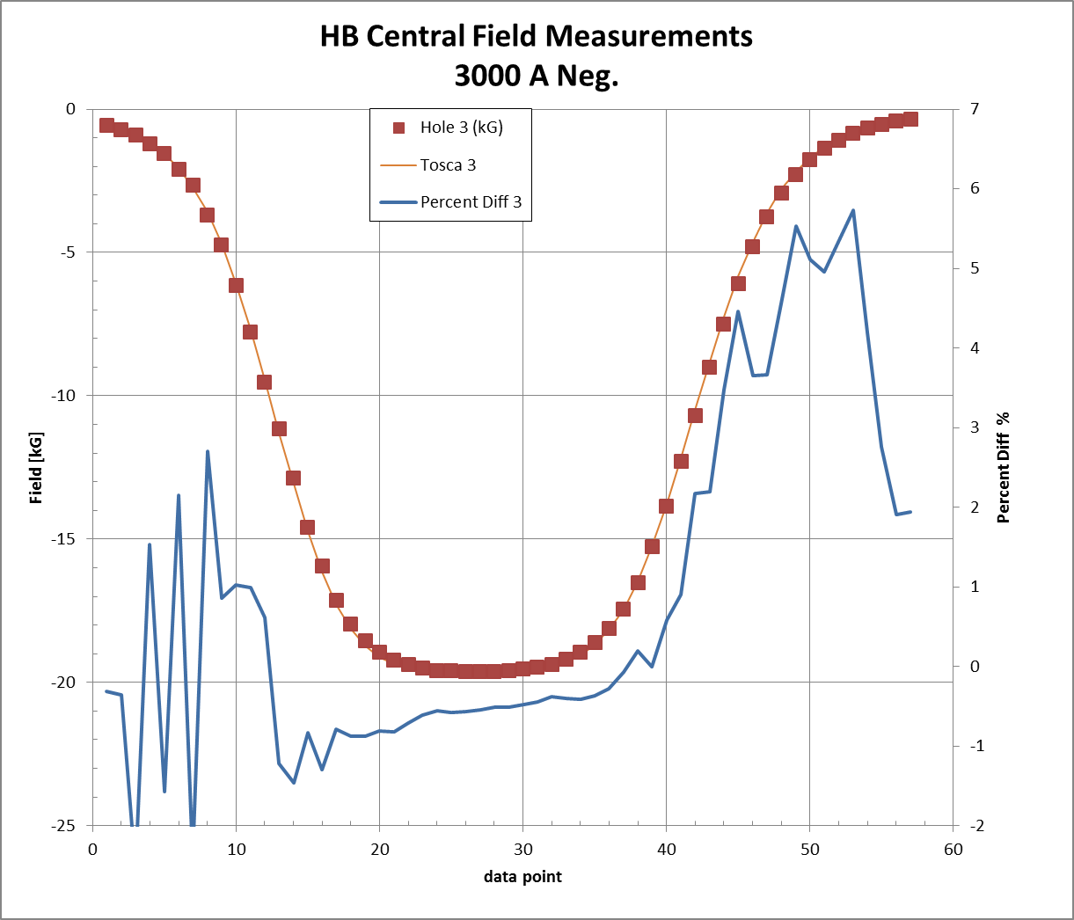
3,000A Tube 1 & 3 (Top and Bottom)
Average Error 1.08%
Average Error 0.87%

Slide 10
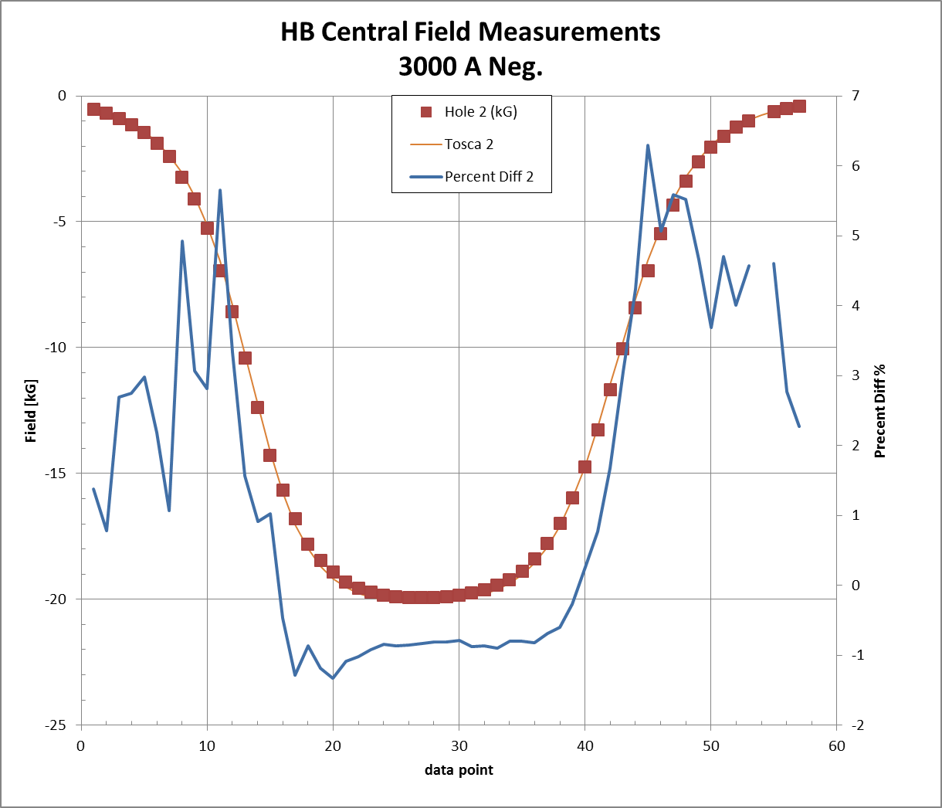
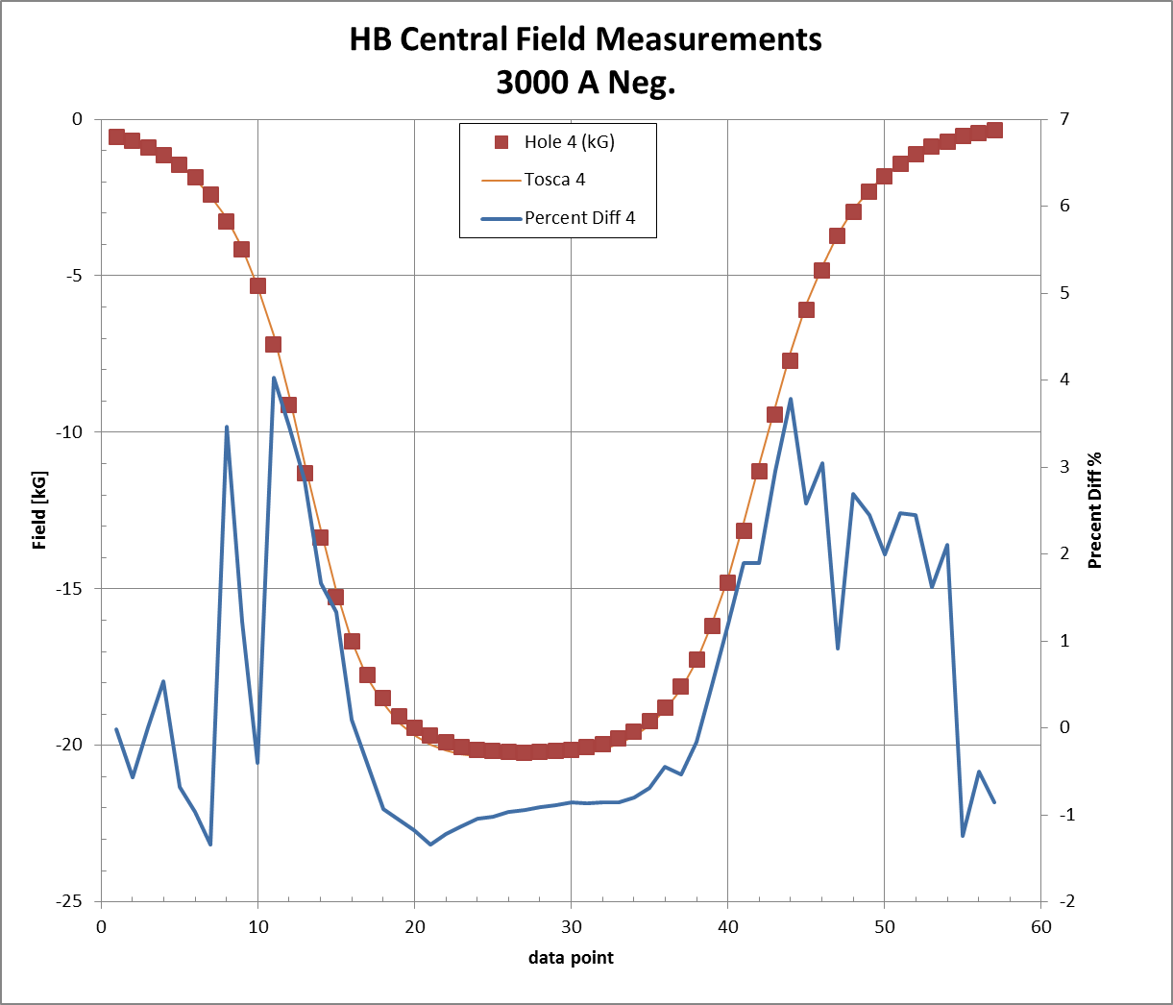
3,000A Tube 2 & 4 (Right and Left)
Average Error 1.43%
Average Error 0.48%

Slide 11
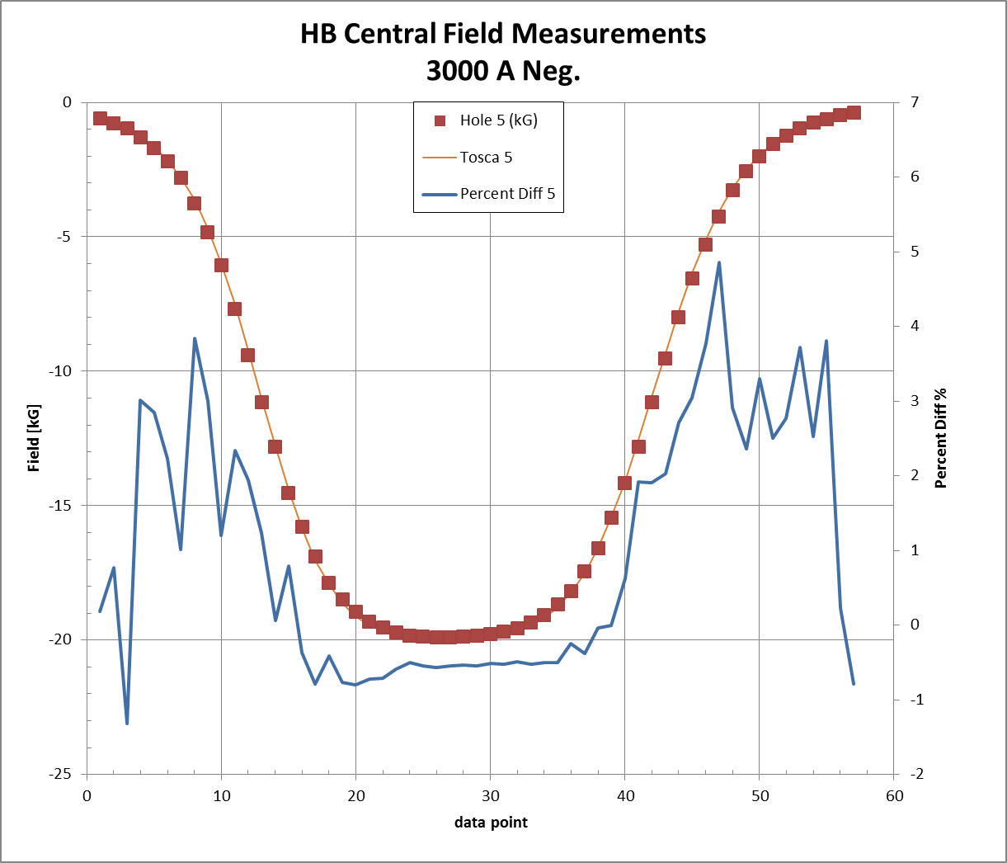
3,000A Tube 5 Center
Average Error 0.97%

Slide 12
3500A

Slide 13
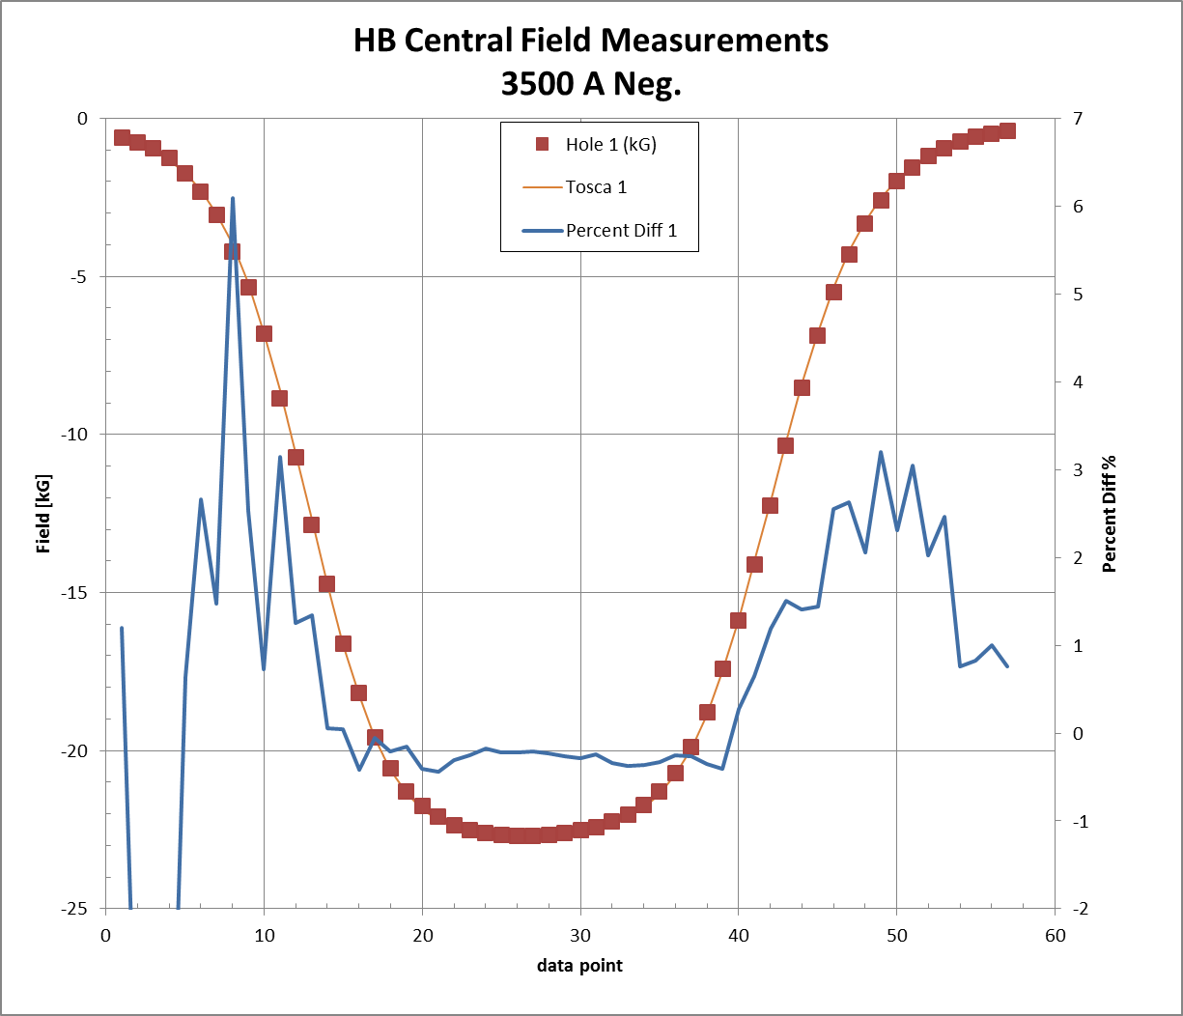
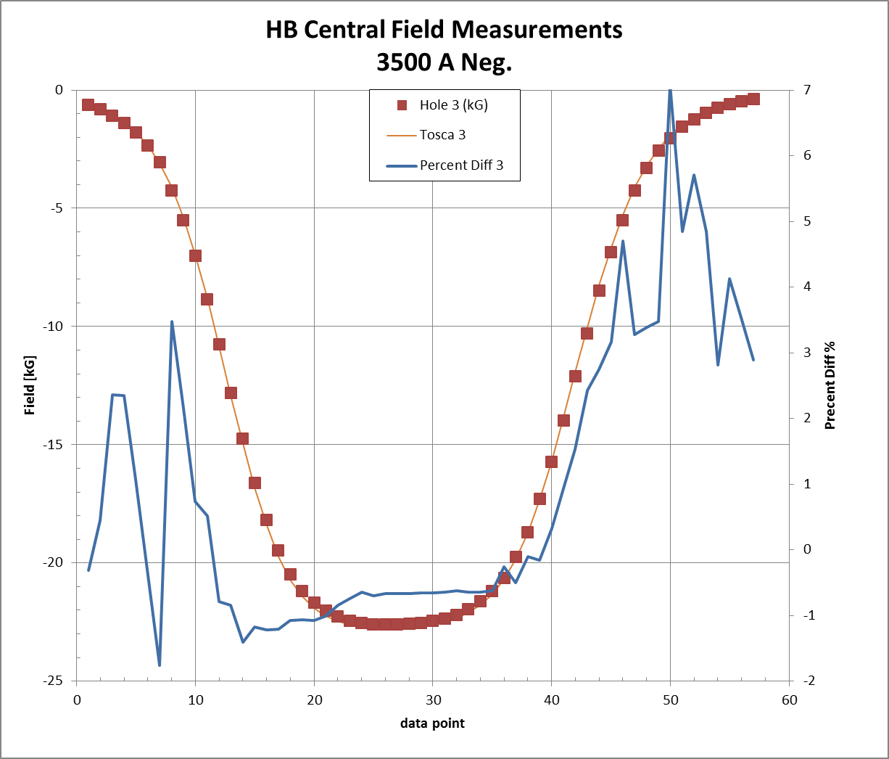
3,500A Tube 1 & 3 (Top and Bottom)
Average Error 0.49%
Average Error 0.90%

Slide 14
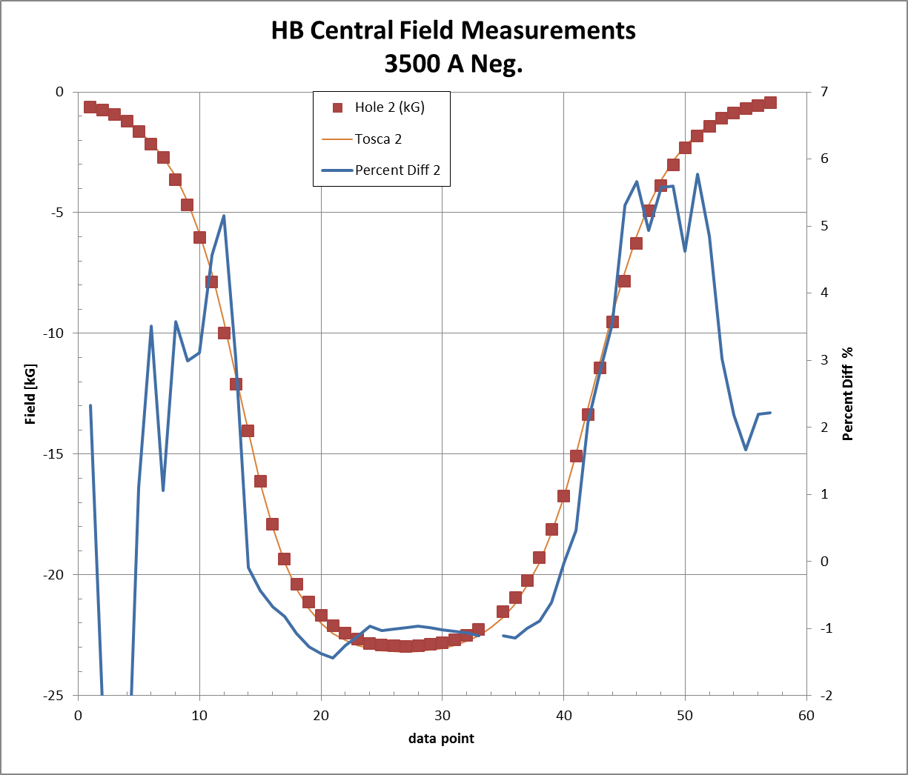
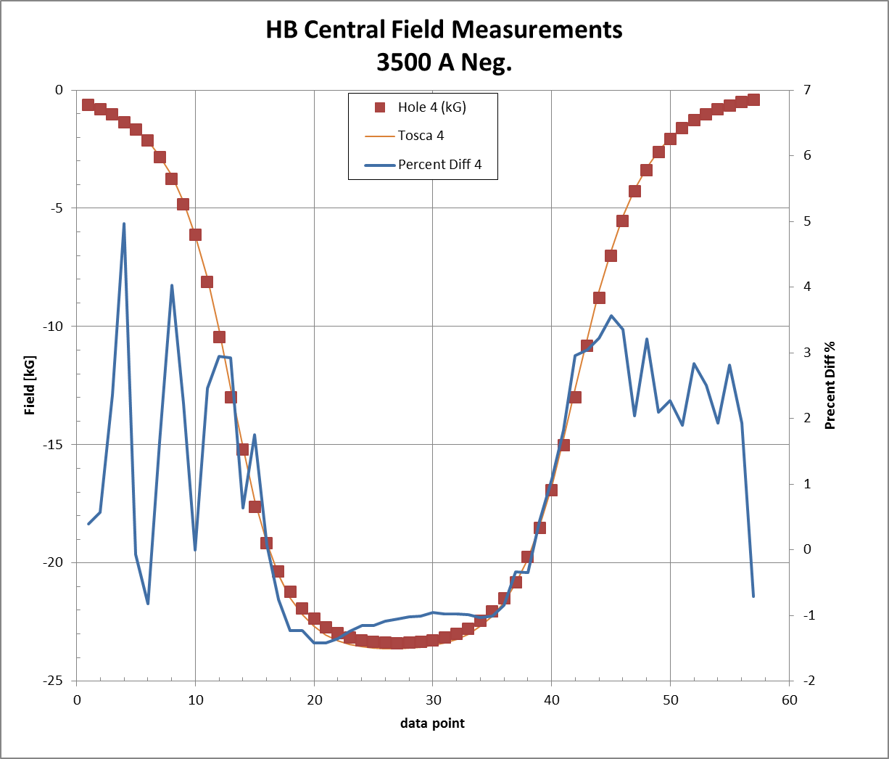
3,500A Tube 2 & 4 (Right and Left)
Average Error 1.01%
Average Error 0.80%

Slide 15
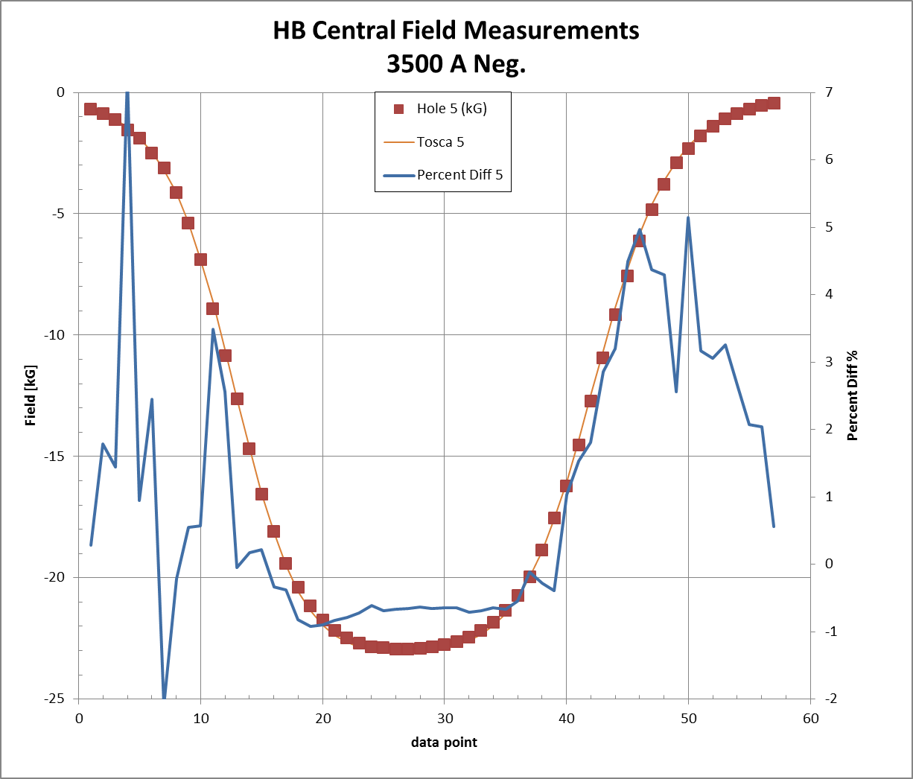
3,500A Tube 5 Center
Average Error 1.01%

Slide 16
3900A notes
Scale changed on field axis

Slide 17
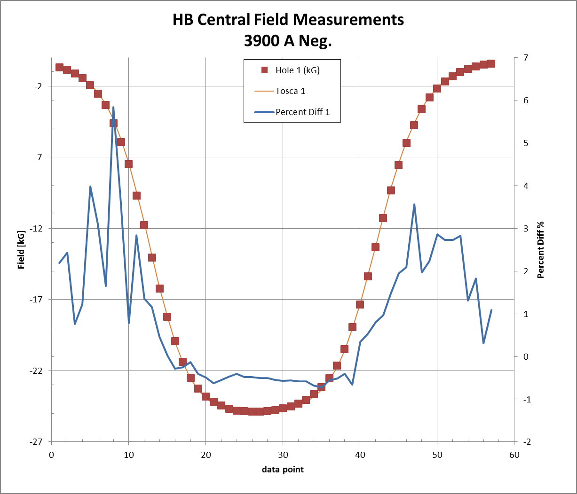
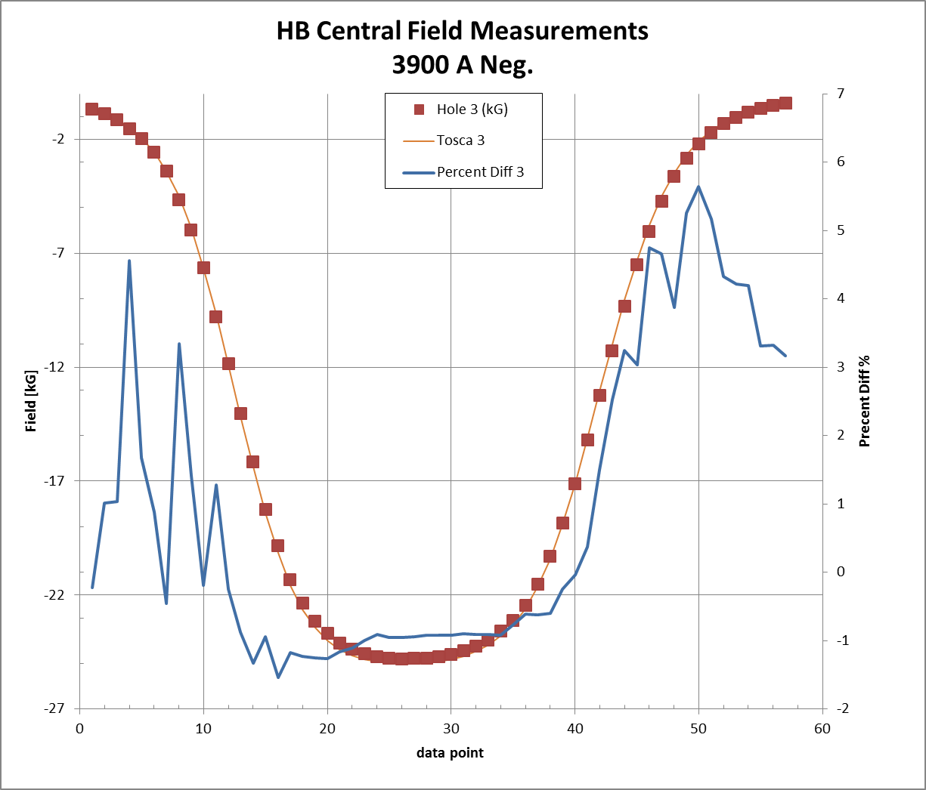
3,900A Tube 1 & 3 (Top and Bottom)
Average Error 0.89%
Average Error 0.89%

Slide 18
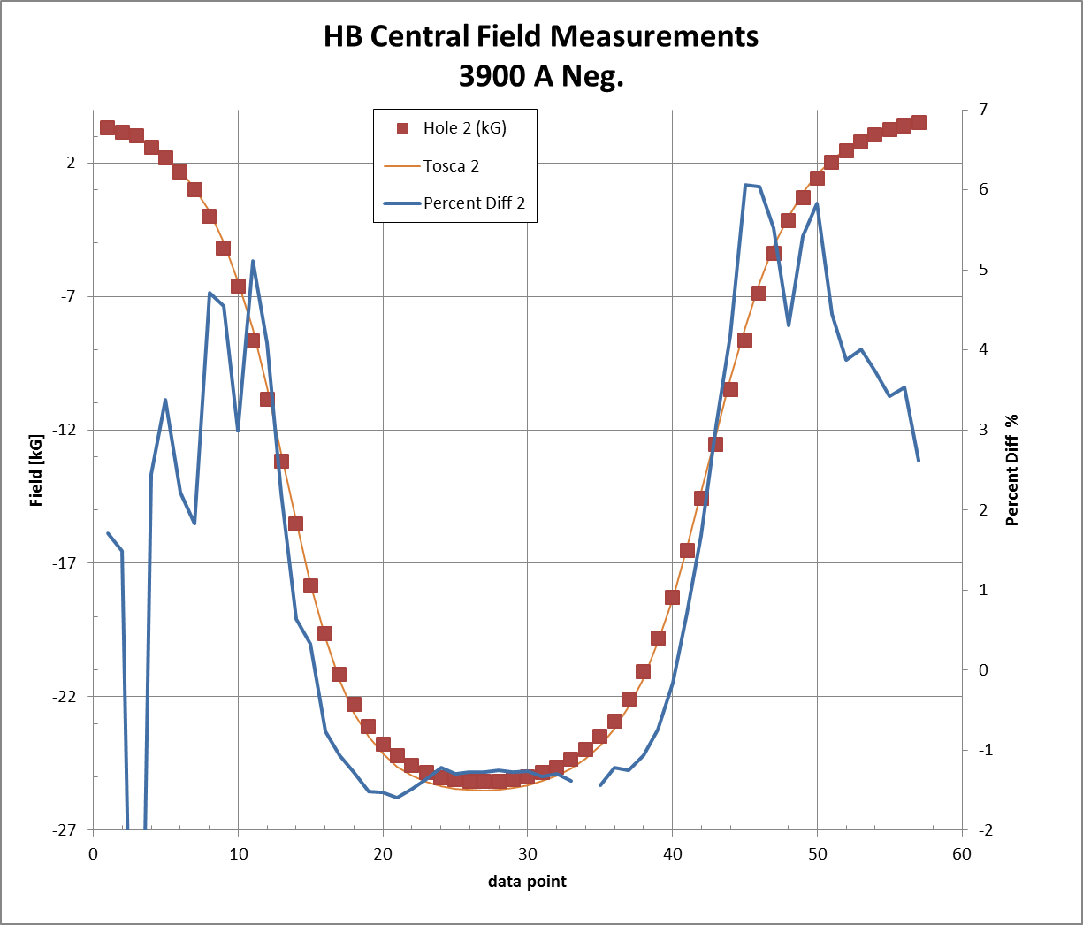
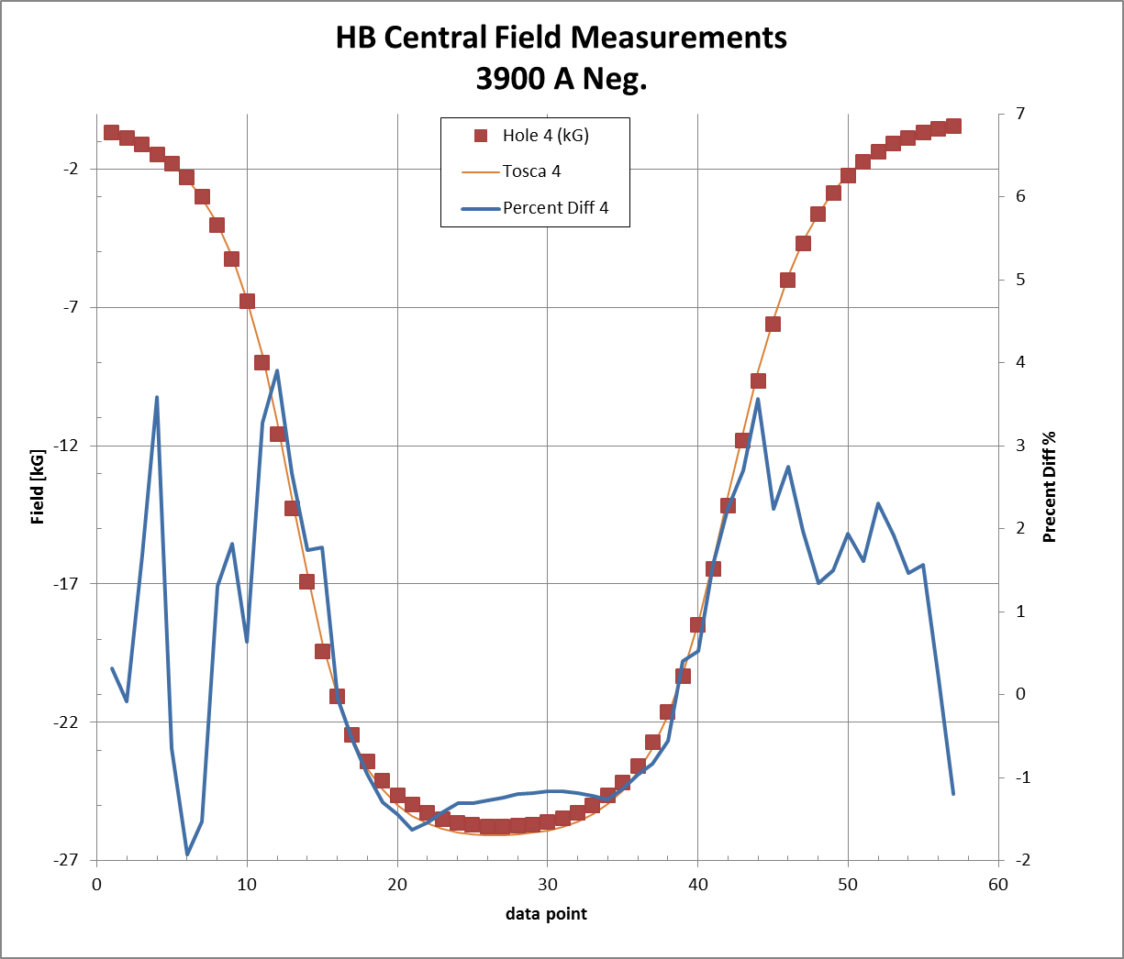
3,900A Tube 2 & 4 (Right and Left)
Average Error 1.23%
Average Error 0.41%

Slide 19
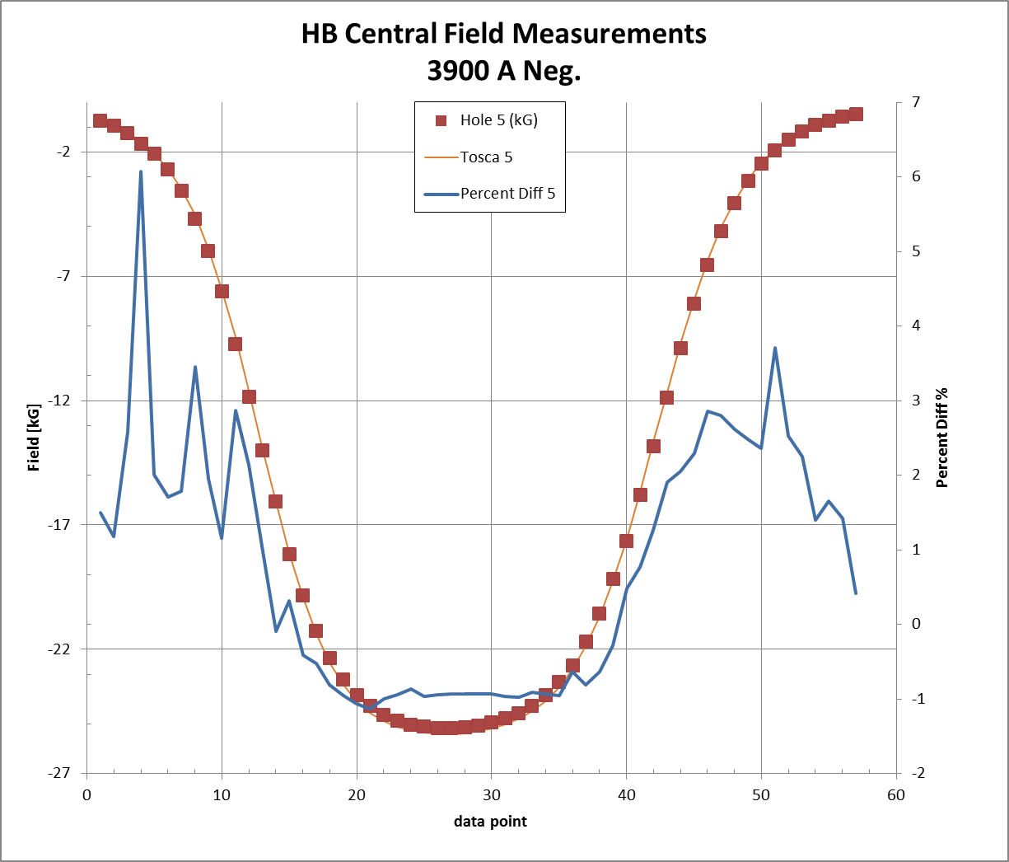
3,900A Tube 5 Center
Average Error 0.78%

Slide 20
Average of Errors along a Tube length
Current [A] | Tube 1 [%] | Tube 2 [%] | Tube 3 [%] | Tube 4 [%] | Tube 5 [%]
2000 | 1.21 | 1.68 | 0.79 | 0.81 | 1.30
3000 | 1.08 | 1.43 | 0.87 | 0.48 | 0.97
3500 | 0.49 | 1.01 | 0.90 | 0.80 | 1.01
3900 | 0.89 | 1.23 | 0.89 | 0.41 | 0.78

Slide 21
Effective Field Length
Sum the fields along the path than multiply by the path length. Total path length is 144.78cm.
Divide by central field Data point #27 & number of data points [57].
Compare to Tosca model

Slide 22
Effective Field Length Tube 5
Current [A] | Measured EFL [cm] | Tosca EFL [cm] | Error [%] | Max Error % / tube #
2000 | 77.31 | 76.81 | -0.65 | -0.84 / 2
3000 | 78.62 | 78.10 | -0.66 | -0.87 / 2
3500 | 78.13 | 77.61 | -0.67 | -0.90 / 4
3900 | 77.90 | 77.36 | -0.70 | -0.98 / 2

Slide 23
Conclusion
Internal field mapping of the HB magnet has been made and compared to a Tosca model.
Agreement of individual data points measured to Tosca data ranges from +7.2% to -10.6%.
Averages of the agreement along the tube ranges from 1.7% to 0.5%.
Largest disagreements occur at the ends of the magnet. Good agreement along the central regions of the magnet.
Long field fall off tail towards Q1 does not appear as it did for the stray field mapping.
Major source of error is positioning probe along Z direction.
Measure Effective length agrees with Tosca model to better than 1%.

